Slide 1
Final Project Extending AES from 128-bits to 192 and 256-bits. Mscs 630- Doc. Pablo Rivas. Due Date: 05/02/2016.
Authors:
Murali Krishna Kandula (200-62-382)
Bhargav Uppalapati (200-62-353)

Slide 2
Objectives:
Introduction
Changes made
Implementing 128-bit Decryption.
Extending AES to support 192-bit Encryption and Decryption.
Extending AES to support 256-bit Encryption and Decryption.
Padding Strategy.
Input and Output.
Authentication Strategy.
Improvements and Extensions.
References.

Slide 3
Introduction:
AES is a type of encryption standard.
Also known as Rijndael (pronounced rain-dahl) algorithm.
AES is a symmetric key algorithm.
AES produces keys on every round of encryption type- Round keys.

Slide 4
Implementing encryption when key size is 192 and 256-bits size
Starts off by running Driver.java file.
Inputs:
Plain text: 128-bits size.
Key: 128, 192, 256-bits size.(Larger the key, greater the encryption).
Diver.java file calls aes() function in aesencryption.java file
Plain text and key are passed as inputs to aes() , which handles other function calls.
Key Size | No. of Rounds | Size of matrix to store round keys
128 | 10 | 4X44
192 | 12 | 4x52
256 | 14 | 4x60

Slide 5
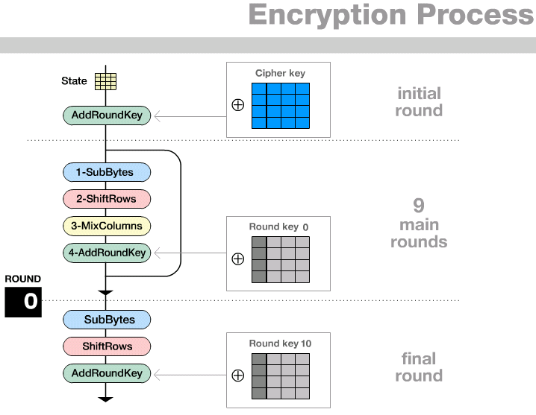
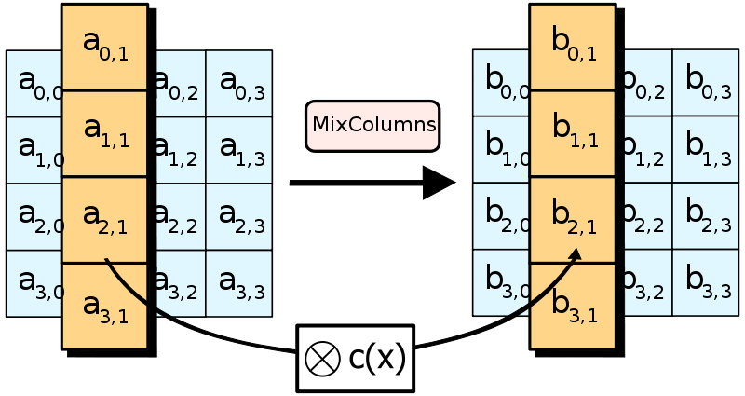
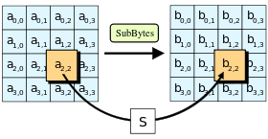
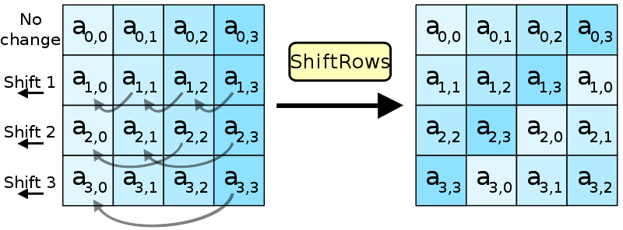
First Round
Add Round Key
Rounds
S_BOX substitution
Shift Rows(different in 256-bit)
Mix Columns
Add Round Key
Final Round (no Mix columns)
S_BOX substitution
Shift Rows
Add Round Key

Slide 6
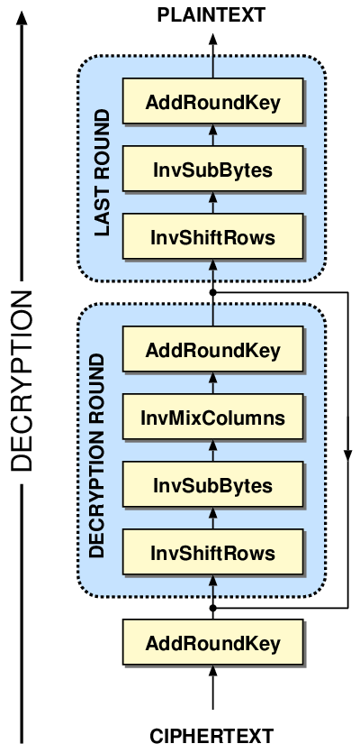
AES Decryption:
Not identical to AES Encryption, since steps done in reverse.
Inputs:
Cipher text: 128-bits size.
Key: 128, 192, 256-bits size.
No. of rounds are determined, depending upon key size.
First Round
Add Round Key
Rounds
Inverse Shift Rows
Inverse S_BOX Substitution
Inverse Mix Columns
Add Round Key
Final Round (no Inverse Mix columns)
Inverse Shift Rows
Inverse S_BOX Substitution
Add Round Key

Slide 7
In decryption, last round key is given as input to the round key matrix.
The next step is XORING cipher text and the last round key.
Next step is implementing inverse shift rows which performs right shift of elements in matrix.
Next step is implementing reverse nibble substitution where corresponding values are pulled from Inverse S_BOX table.
Next is implementing Inverse Mix column operation.
This is a combination of matrix addition and matrix multiplication in the Galois field, but to help with the multiplication look up tables with pre calculated values are present.
last round would be do a XOR between previously generated reverse nibble substitution and the first round key.
The resultant output is the plain text.

Slide 8
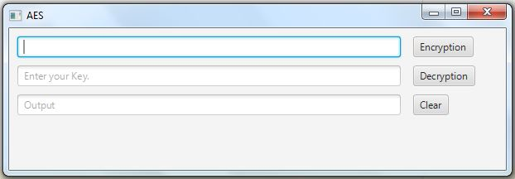
Input and Output

Slide 9
Authentication Strategy
Why SHA 3?
Dissimilarity between SHA 2 and SHA 3, makes SHA 3 more secure.
Less susceptible to collision- finding attacks.

Slide 10
Padding Strategy
Why PKCS7?- As it is easy to implement.
N bytes, each of value N are added.
Ex:
01
02 02
03 03 03
04 04 04 04
Etc.

Slide 11
Improvements and Extensions
Every project has a scope for improvements and extensions.
Our AES can be improved by using a better padding strategy instead of using the PKCS7 as a padding strategy.
Implementing an authentication strategy is a good extension to our AES.
Existing code can always be refined to make it efficient.
UI can be improved to make it look better and user friendly.

Slide 12
QUESTIONS?

Slide 13
References
https://en.wikipedia.org/wiki/Advanced Encryption Standard
https://en.wikipedia.org/wiki/Rijndael S-box
https://en.wikipedia.org/wiki/Rijndael_mix_columns
http://www.angelfire.com/biz7/atleast/mix_columns.pdf
http://www.inconteam.com/software-development/41-encryption/55-aes-test-vectors

